Slide 1
Bacteria-Surface Simulation reformed
Stanley Lo
Mar 24, 2021

Slide 2
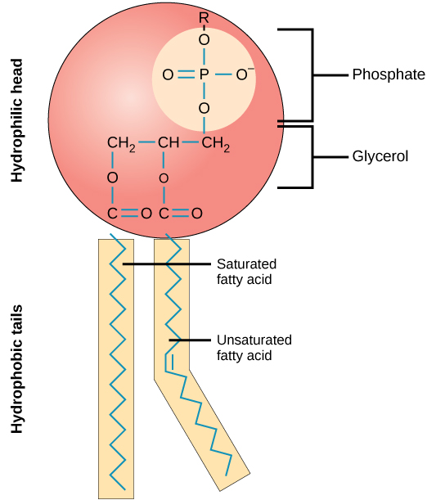
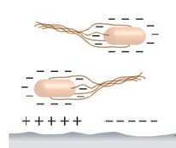
Background
Motivation
Challenge the concept that the most negative bacteria will attach to the most positive surface
Provide insight on the arrangement of surface domains to repel or attract bacteria
Context
Most bacteria have a net negative surface charge
Initial adhesion is mediated by electrostatic and hydrodynamic forces¹
Positive surface domains are more influential than negative surface charge² BUT HOW?
1. Tuson, H. H.; Weibel, D. B. Bacteria–surface interactions. https://pubs.rsc.org/en/content/articlelanding/2013/sm/c3sm27705d (accessed Dec 1, 2020).
2. Zita, A. and Hermansson, M. (1997) Effects of bacterial cell
surface structures and hydrophobicity on attachment to activated sludge flocs. Appl. Environ. Microbiol. 63, 1168-1170.

Slide 3
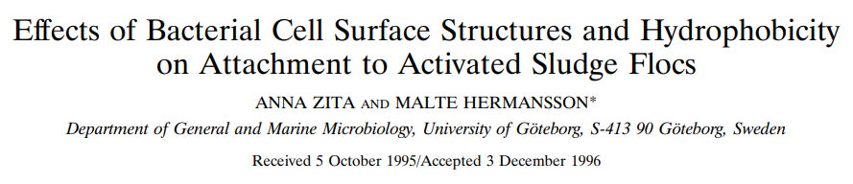
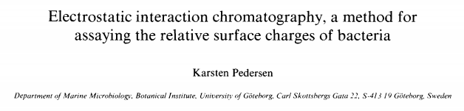
Reversible adhesion by long-range forces
Hydrophobic Interaction and Electrostatic interaction chromatography
Hydrophobicity > Positive charge > Negative charge (adhesion)
Activated sludge flocs consist of numerous constituents such as bacteria, extracellular polymeric substances (EPS), organic and inorganic particles
Net surface charge of bacteria from 0 to strongly negative

Slide 4
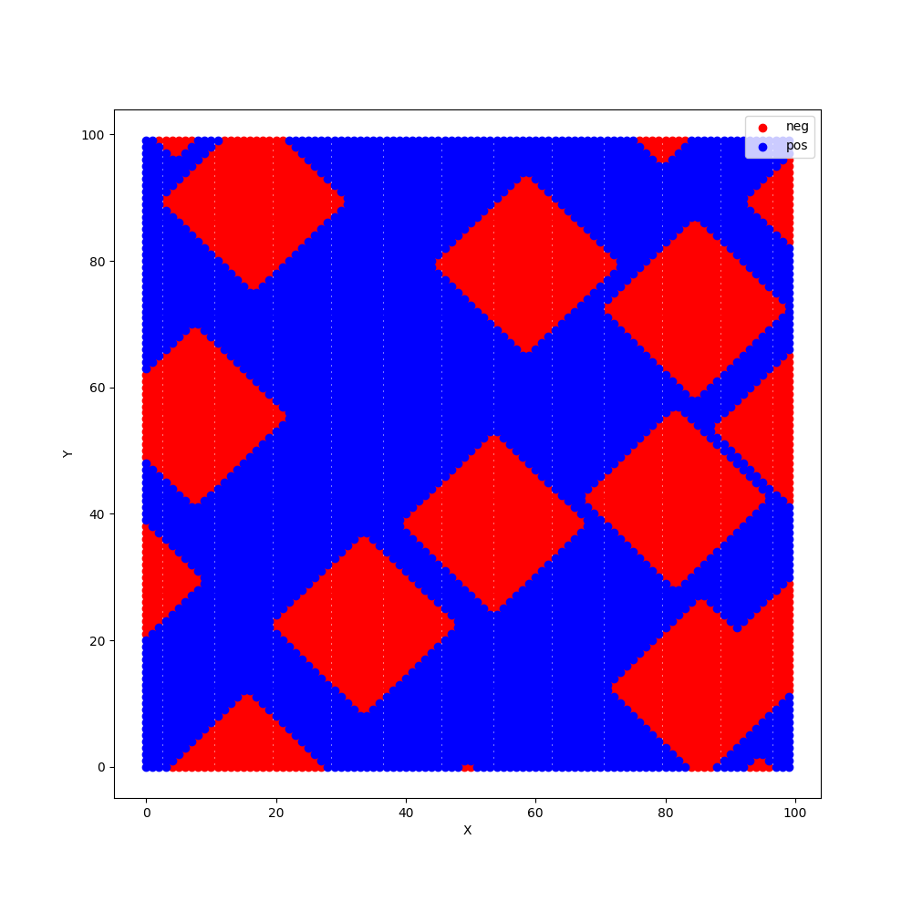
Technicals
Bacteria
Simulation Environment
Matrix space
Assume only electrostatic attraction (+1/-1)
Relative axis
Simplification of model → 2D bacteria and surface, only translations
Bacteria is 10000-fold smaller than the surface
Parameters to change:
Domain size, surface charge, distribution
Random distribution of domains (np.seed())
Net Zero Surface Charge

Slide 5
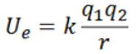
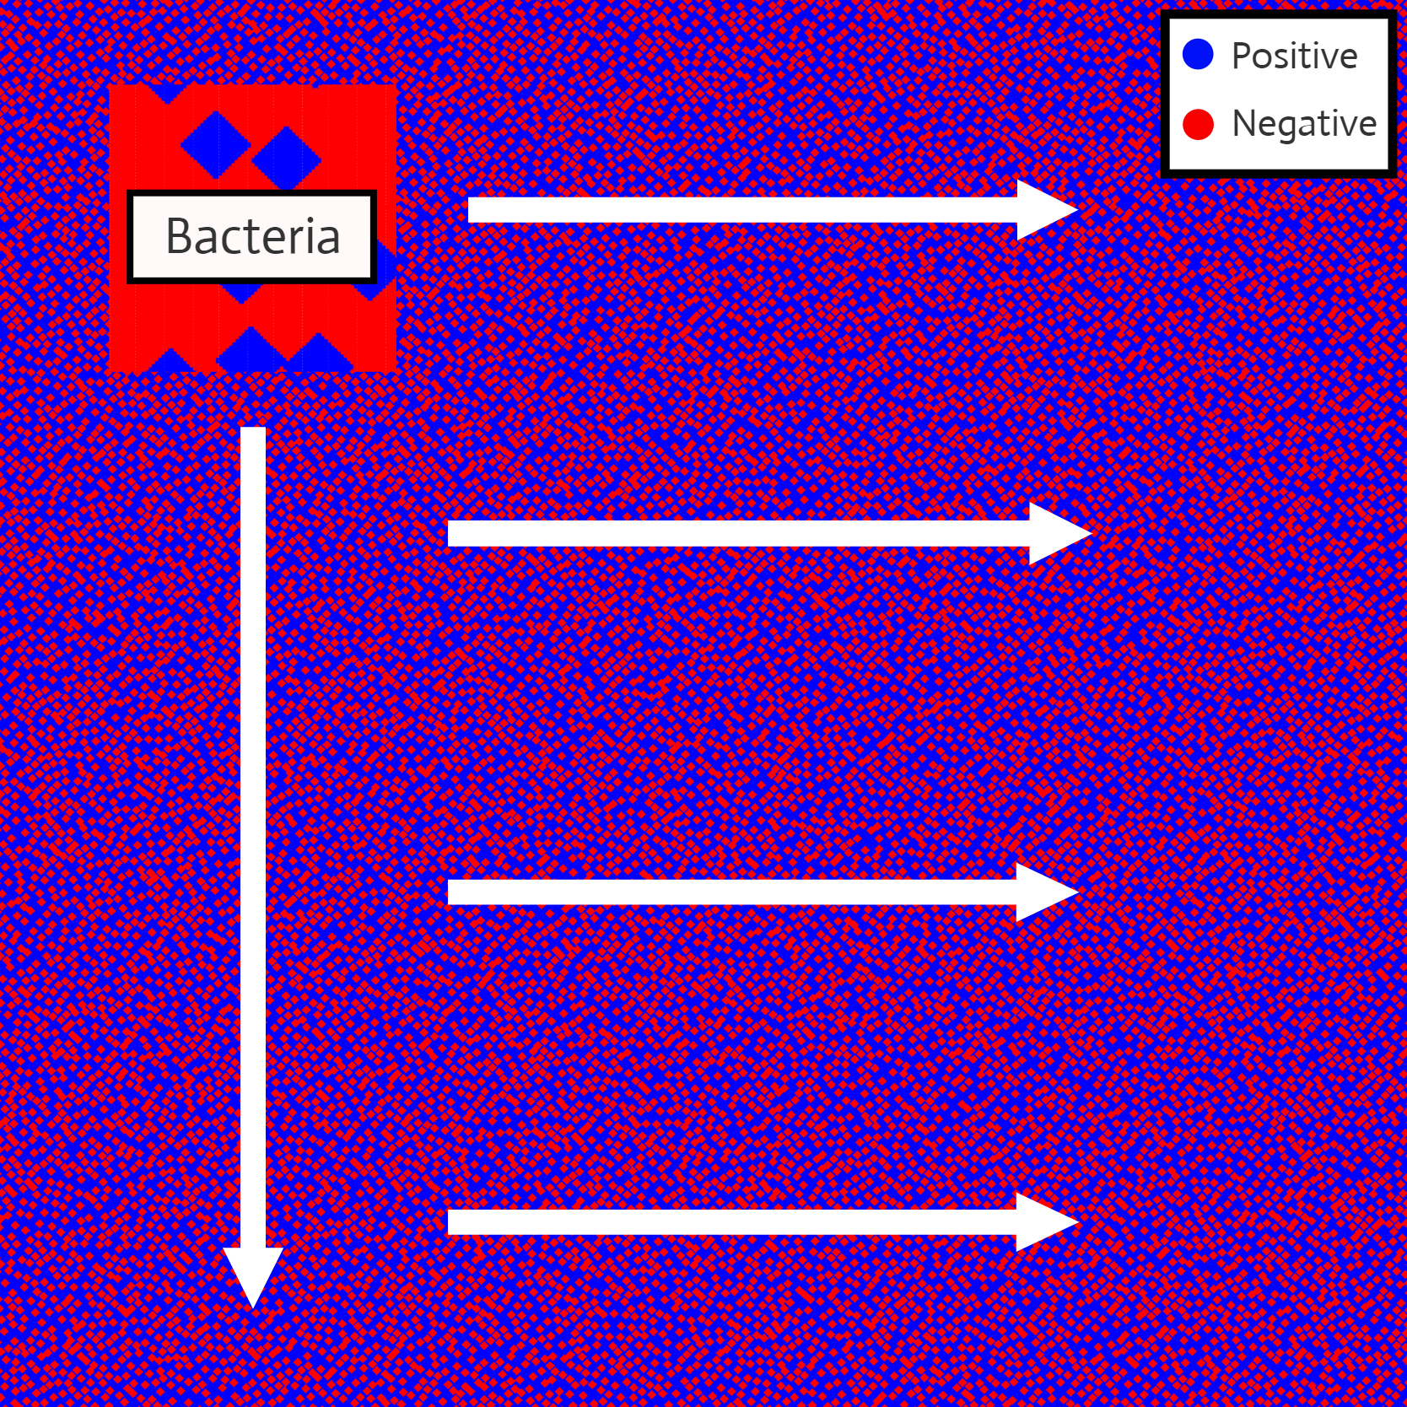
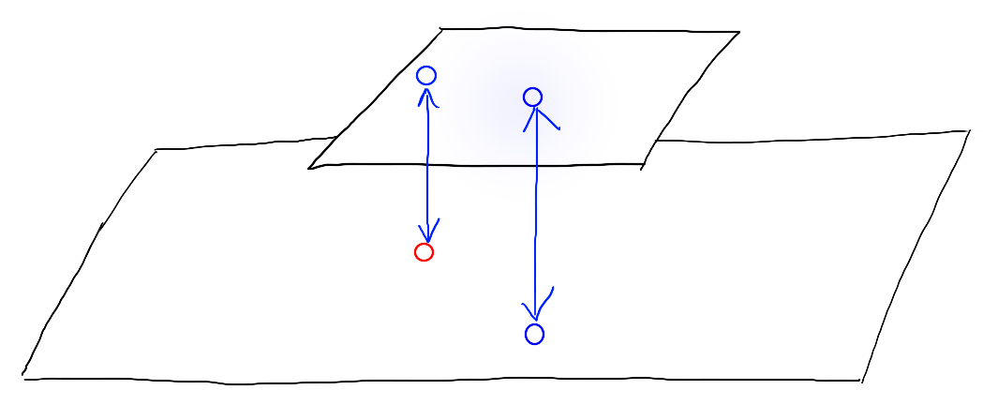
Technicals
Bacteria-Surface Interaction
Scans the entire surface in small intervals.
At each location, the energy is evaluated.
Minimum energy is recorded for each sample.
r = 1
bacteria
Energy = -1
Energy = +1
surface

Slide 6
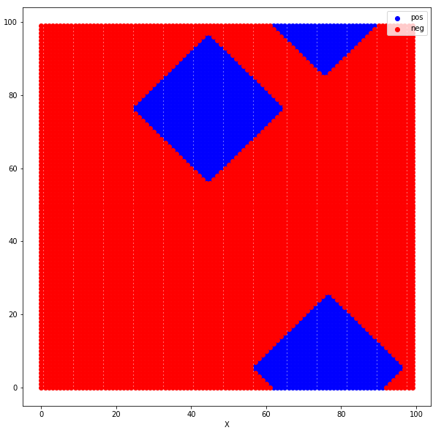
Experiment 1 – changing bacteria
Bacteria:
Random bacteria sample (200+/domain size)
20% positive, 80% negative
Varying domain sizes
100 x 100 pts
Surface:
1 randomly generated surface
Net zero surface charge (50% positive, 50% negative)
Constant domain size (264pts/domain)
Largest domain size (840pts)

Slide 7
Experiment 1 – changing bacteria
Results and Discussion:
Each datapoint is the average of 200 samples.
The minimum interaction energy correlates to matching domain sizes

Slide 8
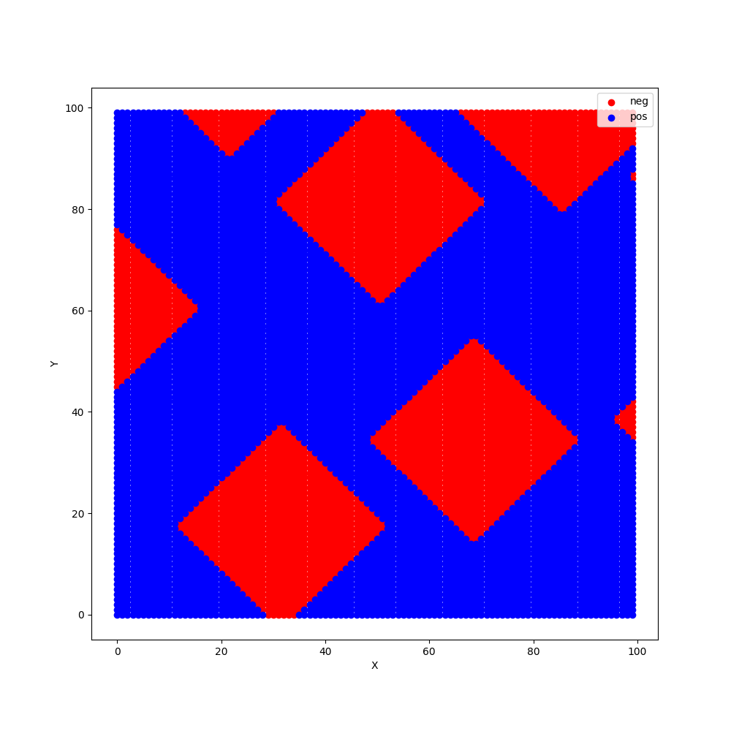

Experiment 2 – changing surface
Bacteria
1 randomly generated bacteria
20% positive, 80% negative
Constant domain size (264pts/domain)
Surface
Random surface samples (200+/domain size)
Net zero surface charge (50% positive, 50% negative)
Varying domain size
Surface Domains:
High magnification
Medium magnification
No magnification

Slide 9
Experiment 2 – changing surface
Results:
Each data point is the average of 200 samples

Slide 10
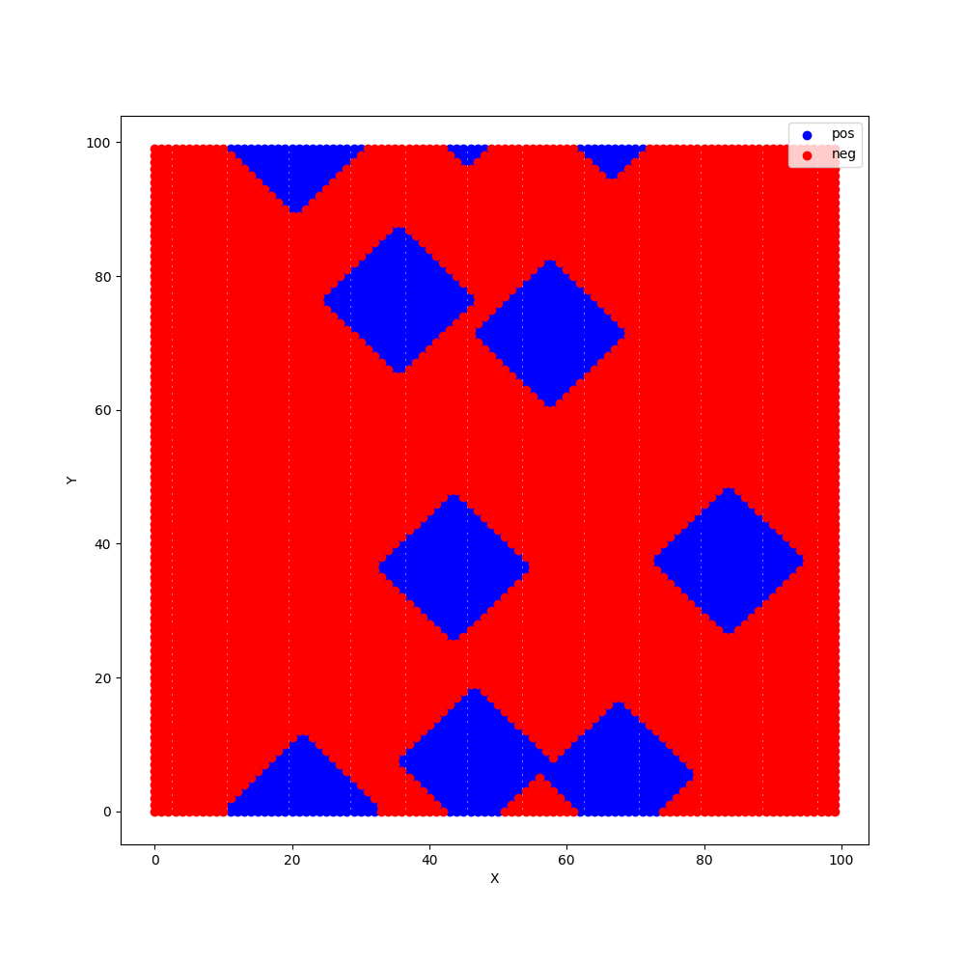
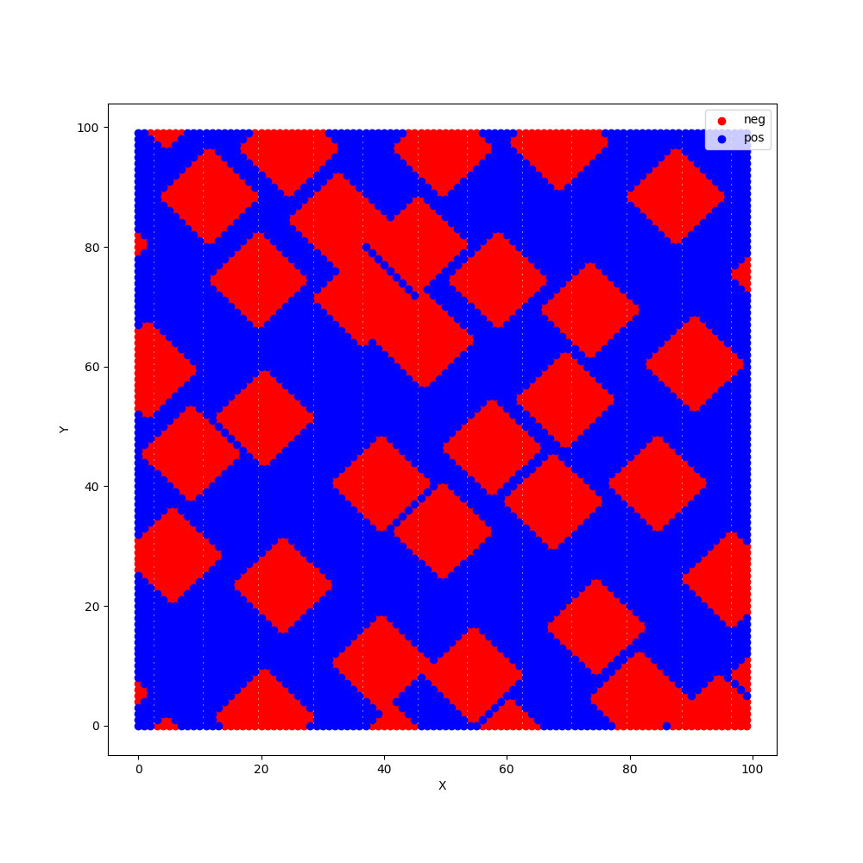
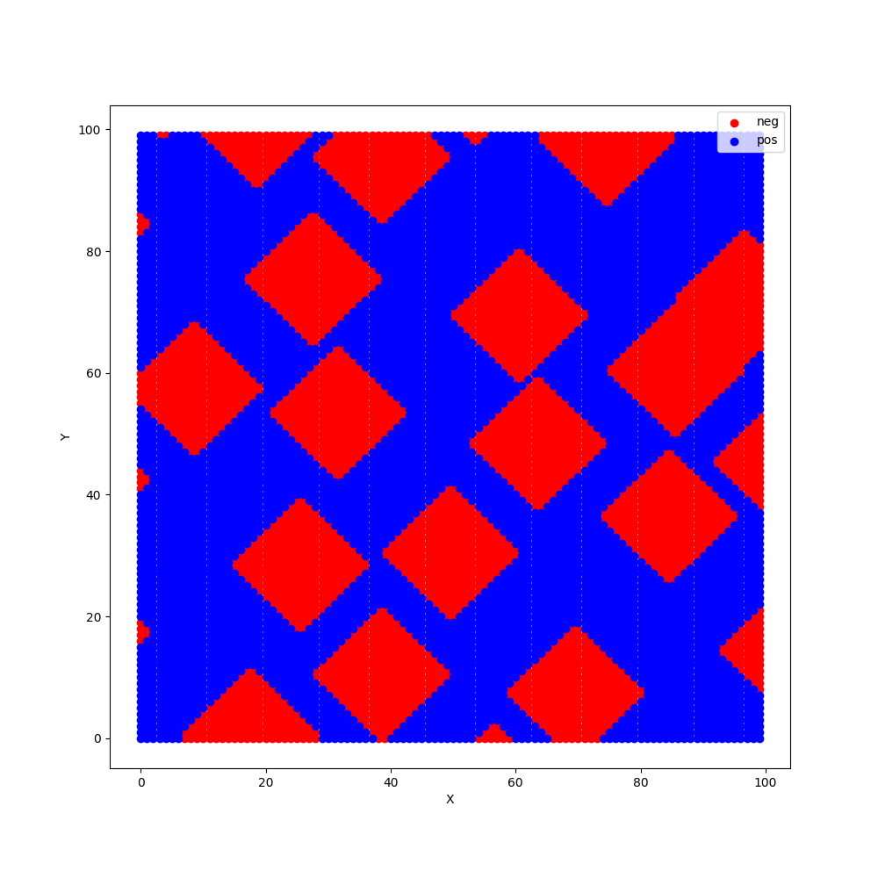
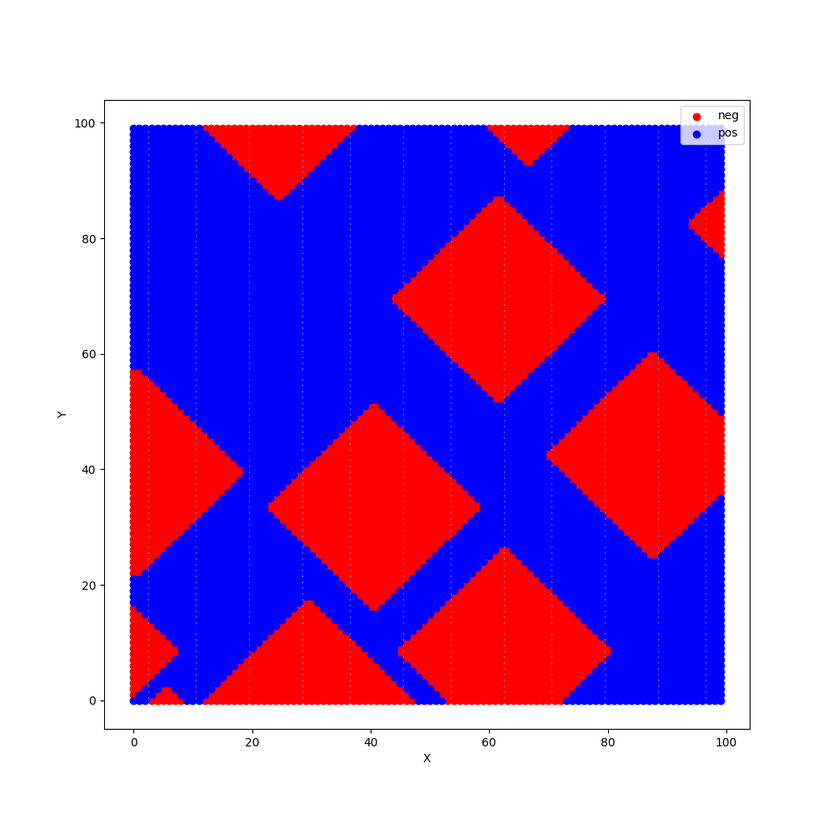
Experiment 2 – changing surface
Discussion:
Why does energy keep decreasing? Do larger domains dominate?
Let’s look at the surface domains directly underneath the bacteria:
Bacteria:
(264pts/domain)
Surface:
264pts/domain
684pts/domain
144pts/domain
Notes:
Domains match up better because the surface has a higher concentration so there is less mismatching unlike the smaller domains.

Slide 11

Experiment 3 – changing surface (revised)
Bacteria
1 randomly generated bacteria
20% positive, 80% negative
Constant domain size (264pts/domain)
Surface
Random surface samples (100+/domain size)
(80% positive, 20% negative)
Varying domain size
Surface Before
Surface after

Slide 12
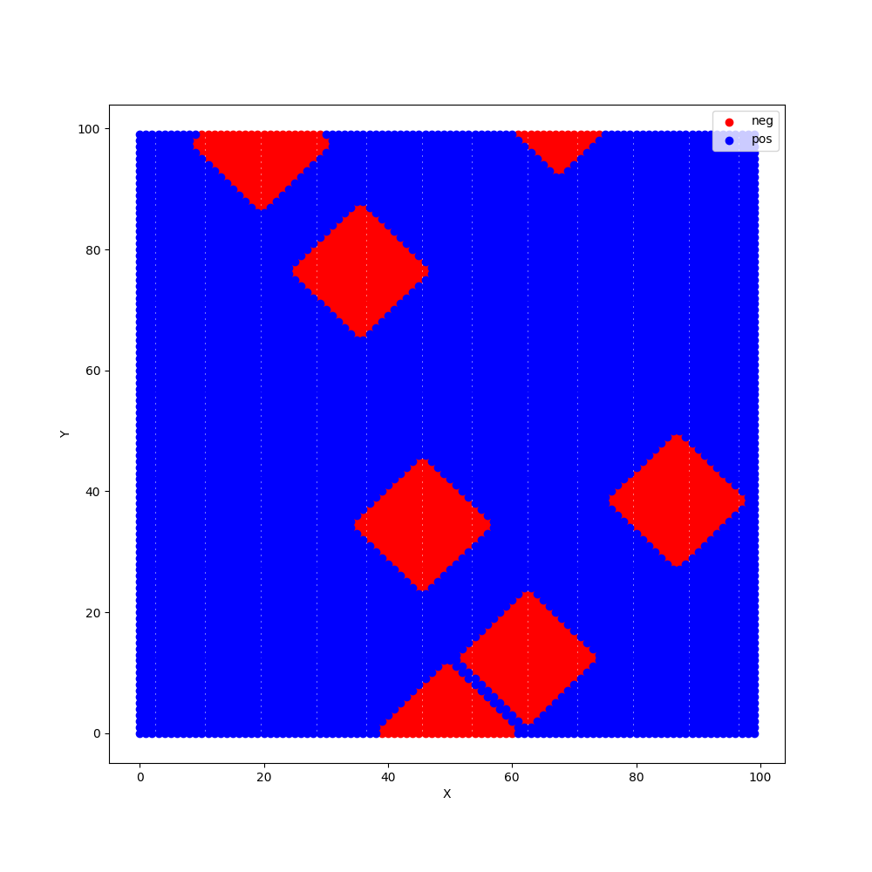
Experiment 3 – changing surface (revised)
Bacteria
Results and Discussion:
Surface

Slide 13
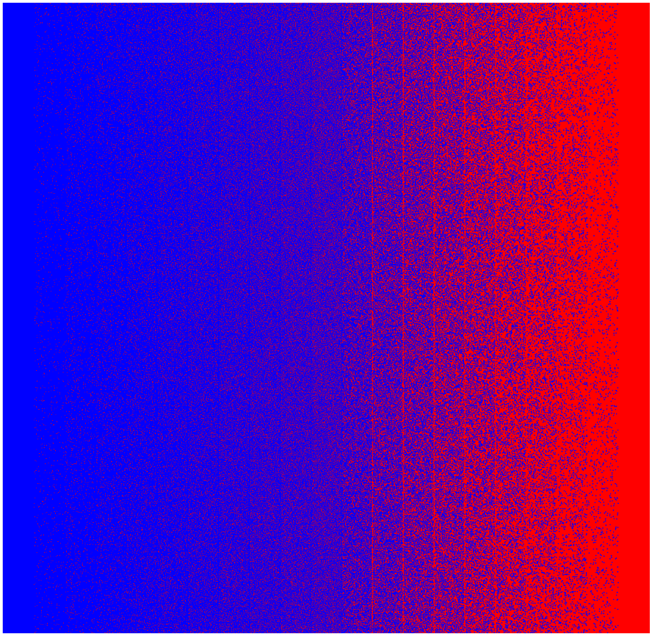
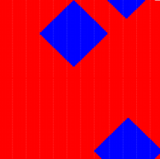

Conclusion
The macroscopic concept does not dominate the interaction
Optimal design of surface → Similar domain size, and similar concentrations (opposite of the bacteria)

Slide 14
Future Work
Translate to a physical experiment in differentiating bacteria with surfaces
ESIC for the concentration of surface charges
How about size of domains on bacteria?
Topography of surfaces, the 3D structures of surfaces

